Slide 1
Diabetes Prediction Using Machine Learning [SVM]
K. POORNATEJITHA
H. GAYATHRI
S. SAI RAM

Slide 2
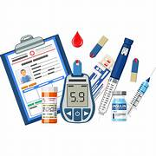
INTRODUCTION
Diabetes is common chronic disease that can be dangerous.
Diabetes can be identified when blood glucose is higher than normal level which is caused by high secretion of insulin or biological effects.
Diabetes can cause various damage to our body and disfunction tissues, kidneys, eyes and blood vessels.
In this system an efficient way of detecting diabetes is done through machine learning.
Under machine learning we can use the classification algorithm Support Vector Machine [SVM].

Slide 3
SUPPORT VECTOR MACHINES(SVM)
To predict diabetes we used Support Vector Machine algorithm.
SVM used for both regression and classification.
They work by finding the optimal hyperplane that maximizes the margin between different classes.
SVMs are known for their effectiveness in high-dimensional spaces and various applications, such as image and text classification.

Slide 4
PARAMETERS TAKEN FOR TESTING
Glucose
Insulin
BMI
Age

Slide 5
LIBRARIES
Libraries we used for this project:
Numpy
Pandas
Sklearn
Pickle

Slide 6

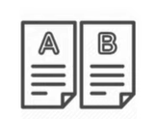

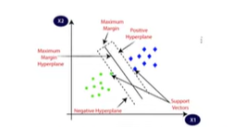
BLOCK DIAGRAM
Diabetes dataset
Data preprocessing
Train-test-split
SVM classifier

Slide 7
Diabetic
(or)
Non-Diabetic
New Data
Trained SVM classifier
Prediction

Slide 8
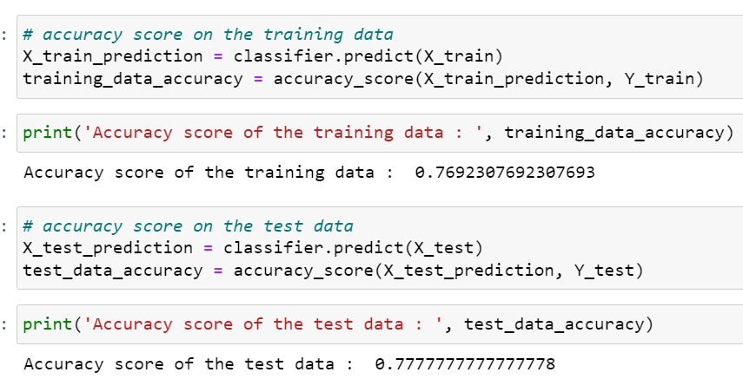
ACCURACY

Slide 9
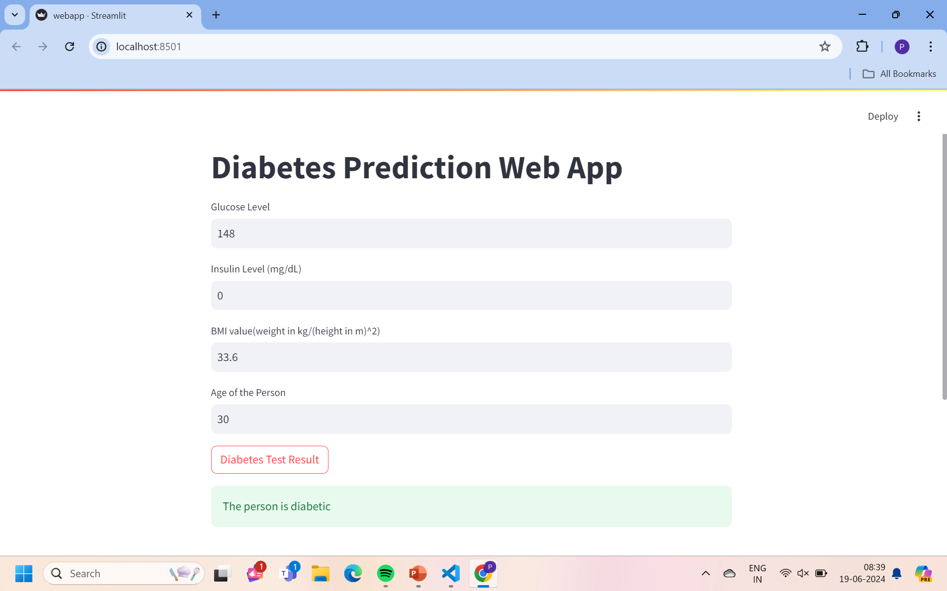
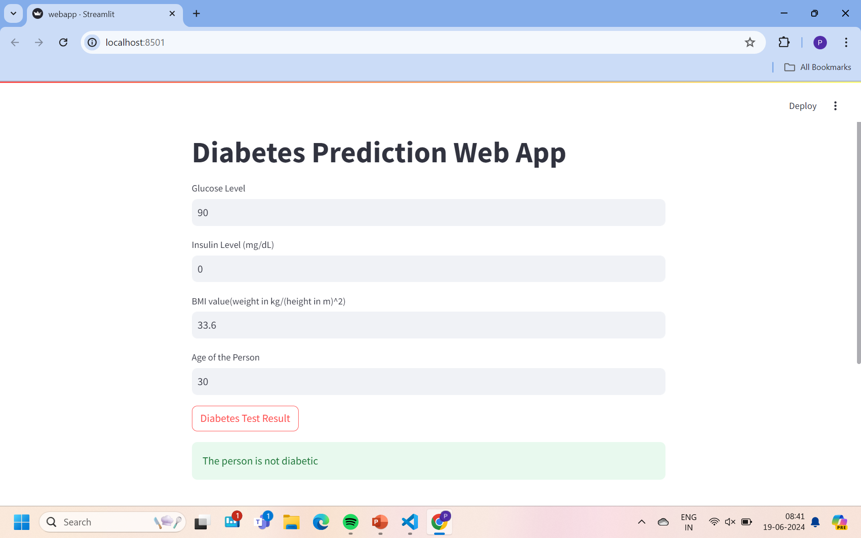
RESULTS

Slide 10

CHATBOT

Slide 11
ADVANTAGES
Early Detection
Cost –Efficient
Can be used for self testing

Slide 12
CONCLUSION:
In this project , we successfully developed a predictive model using Support Vector Machines(SVM) for the task of diabetic prediction based on various health parameters.
Through meticulous data preprocessing, feature engineering, and model training, we have created a robust classifier capable of distinguishing between diabetic and non-diabetic individuals with high accuracy.
Overall, this project highlights the significance of machine learning approaches, particularly SVM, in addressing complex healthcare challenges such as diabetes.
Overall, the project contributes to better diabetes prevention and care.
In this conclusion, the use of Support Vector Machines presents a promising avenue for predicting diabetes.

Slide 13
THANK YOU

